Slide 1
Decide if True OR False AND Explain WHY:
1. All cultures are the same.
2. Cultural practices are only dictated by wealthy societies
3. Sociologists consider western culture superior to all other cultures.

Slide 2
All cultures are the same.
True: All countries consist of the same basic elements, such as religion, housing and family.
False: Societies have created many different cultures in which language, values, beliefs, and practices vary a great deal.

Slide 3
Cultural practices are only dictated by wealthy societies
True: Wealthy societies produce most of the culture and entertainment that is popular around the world and thereby dictate many cultural practices.
False: Each society dictates its own cultural practices.

Slide 4
Sociologists consider western culture superior to all other cultures.
True: Western culture is superior because it is more technologically advanced and provides a better quality of life.
False: Cultures cannot be ranked and should be considered on their own merits.

Slide 5
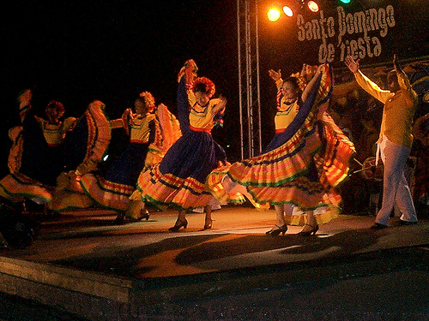
CHAPTER 2
Cultural Diversity
Section 1: The Meaning of Culture
Section 2: Cultural Variation

Slide 6
Objectives:
Define the meaning of the term culture and explain how material culture and nonmaterial culture differ.
Identify and describe the basic components of culture.

Slide 7
What is Culture???
Culture: consists of all the shared products of human groups.
Material culture: physical objects created by human groups. EX: cars, books, clothing, computers.
Nonmaterial culture: abstract human creations, such as language, ideas, beliefs, rules, skills, family patterns, work practices, and political and economic systems.

Slide 8
Difference between culture and society:
Society: a group of interdependent people who have organized in such a way as to share a common culture and feeling of unity.
Society consists of people, and culture consists of material and nonmaterial products that people create.

Slide 9
SECTION 1
The Meaning of Culture
Question:
How do material culture and nonmaterial culture differ?

Slide 10
SECTION 1
The Meaning of Culture
CULTURE
all the shared products of human groups
Material Culture
Non material Culture
physical objects that people create and use
abstract human creations
Examples
Examples
automobiles, books, buildings, clothing, computers, and cooking
beliefs, family patterns, ideas, language, political and economic systems, and rules

Slide 11
Nonverbal Cross-Cultural Communication
It is estimated that 90% of what we communicate,
we say without words!

Slide 12
The components of culture:
Technology
Symbols
Language
Values
Norms

Slide 13
Technology
Knowledge and tools people use for practical purposes.
Sociologists interested in skills AND acceptable behaviors when using material culture.

Slide 14
Symbols
Anything that represents something else.
Although symbols vary, all cultures communicate symbolically.

Slide 15
Language:
The organization of written or spoken symbols into a standardized system.

Slide 16
Focus/Review
Describe a value of yours that differs from your friends and/or family. Describe how your value is different and comment on any problems this has caused you.

Slide 17
American Tongues
A film about the way we talk.
40 minutes.
Please follow along with the video by completing the handout provided!! All questions are in order of video.

Slide 18
Values:
Shared beliefs about what is good or bad, right or wrong, desirable or undesirable.
EX: the value of respecting others and being concerned for human life.

Slide 19
Do you share the SAME values as your friends?

Slide 20
As I read EACH statement, decide which label you agree with:
Go to the sign that reflects how you feel about the statement.
Agree, Disagree, Unsure
I will give you a few minutes to discuss your views with each other….decide on ONE spokesperson to summarize your views.
Keep tally of the number of friends in EACH group!

Slide 21
Statement #1:
Although we should not be unnecessarily cruel to animals, they were put on earth to serve the needs of human beings.
Agree, Disagree, Unsure

Slide 22
Statement #2:
The death penalty should be abolished
Agree, Somewhat Agree, Disagree, Unsure

Slide 23
Statement #3:
Men and women are not politically or intellectually equal because they are biologically different.
Agree, Disagree, Unsure

Slide 24
Statement #4:
There is too much violence and sex in the media, especially on television.
Agree, Disagree, Unsure

Slide 25
Statement #5:
Millenials are, generally, an awful generation.
Agree, Disagree, Unsure

Slide 26
Question to Consider:
Do you and your friends have the
same values???

Slide 27
Norms:
Shared rules of conduct that tell people how to act in specific situations.
EX: respect for the American flag

Slide 28
Norms are expectations for behavior, NOT actual behavior.
EX: Not all people pay their bills.

Slide 29
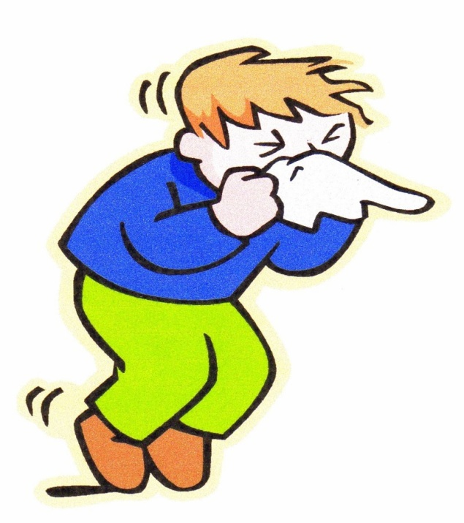
As simple as cover your mouth when you sneeze to complex such as do not kill a human being.

Slide 30
Homework
Ch 2 section 1 reading
Describe cultural trait, cultural complexes, and cultural patterns. Give 2 original (not in book or given by teacher) examples of each

Slide 31
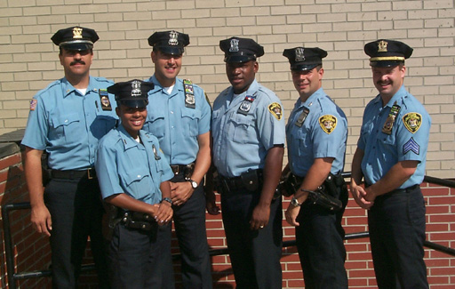
Norms are also applied selectively.
EX: Taking someone’s life is different for police officers and military.

Slide 32
Two Types of Norms:
Folkways
2. Mores (MOR-ayz)

Slide 33
Folkways:
Norms that describe socially acceptable behavior but do not have great moral significance attached to them.
EX:
Do not place a knife in your mouth.
Shake hands when introduced.
Do your homework
Nonconformity does NOT endanger the well-being or stability of society.

Slide 34
Mores:
Norms that have a GREAT moral significance attached to them.
Violation of rules endangers society’s well-being.
EX: murder, fraud, dishonesty

Slide 35
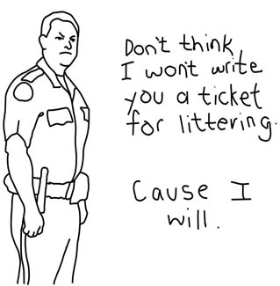
Laws:
Written rules of conduct enacted and enforced by the government.
Essential for social
stability when violating
mores.

Slide 36
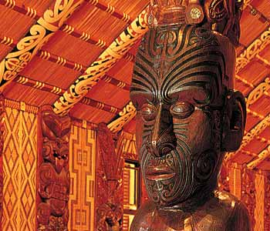
Features of culture divided into 3 levels
Traits
Complexes
Patterns

Slide 37
Culture Traits:
Simplest level
An individual tool, act, or belief that is related to a particular situation or need.
EX:
Using knives, spoons, forks
Saying hi to friend

Slide 38
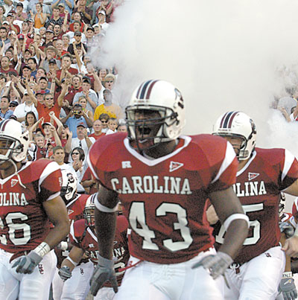
Culture Complexes:
Cluster of interrelated cultural traits.
EX: Football
Football, helmets, pads, sideline benches, running, blocking, tackling, rules, penalties.

Slide 39
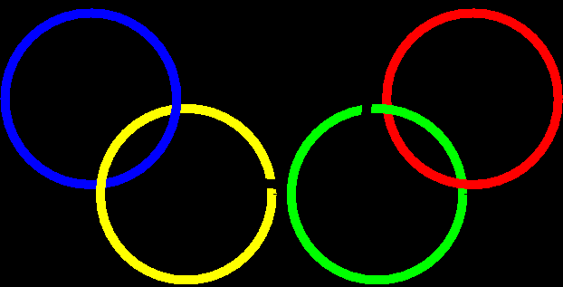
Culture Patterns:
The combination of a number of culture complexes into an interrelated whole.
EX: Baseball, basketball, football, soccer, etc…combine to form the American athletic pattern.

Slide 40
End of Chapter 2: Section 1
24 minute culture video

Slide 41
Chapter 2: Section 2
Cultural Variation

Slide 42
Objectives:
Describe cultural universals and explain why they exist.
Explain what the terms ethnocentrism and cultural relativism mean.
Identify factors that account for variations among and within cultures.

Slide 43
What do we have in common??
Culture universals:
Common features that are found in all human cultures.
Anthropologist George Murdock developed a list of general traits that are common to ALL cultures (more than 65 cultural universals):
Cooking, dancing, family, feasting, forms of greeting, funeral ceremonies, gift giving, housing, language, medicine, music, myths and folklore, religions, sports, and toolmaking.

Slide 44
What do you think?
What might be the reason for some cultural differences between Canada and the United States?

Slide 45
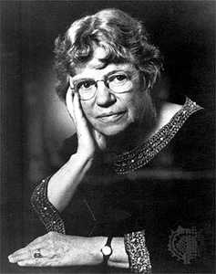
Variation Among Societies:
Anthropologist Margaret Mead studied the differences in culture between the Arapesh and the Mundugumor.
Lived 100 miles apart, but
VERY different cultures.

Slide 46
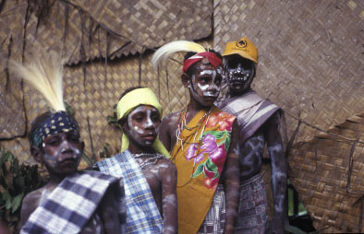
The Arapesh:
Gentle, nonaggressive, receptive, trusting, and warm people.
Live in close-knit villages.
Children are discouraged from displaying any aggression towards others.

Slide 47
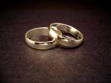
The Arapesh:
Arranged marriages
Most marriages consist of one husband and one wife
However, some men have two wives.

Slide 48
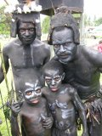
The Mundugumor:
Aggressive!!
Men and women competitive, jealous, and violent.
Enjoy fighting
Great hostility between fathers and sons
Sisters and mothers as well

Slide 49
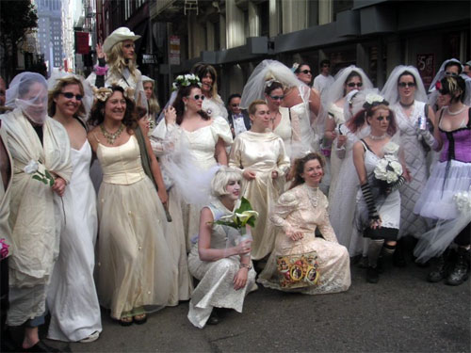
The Mundugumor:
The more wives, then the more power and wealth. (8-10 wives)

Slide 50
The Mundugumor:
Children tend to push parents apart.
Father wants daughter to trade for another wife.

Slide 51
The Mundugumor:
Infants are carried in rigid basket that gives no contact with mother!!
Left hanging in basket in house when mother works outdoors.
Not picked up or comforted!

Slide 52
Rules for Mundugumor Children:
Do not wander out of sight
Do not cling to our mother
Do not go to the houses of your fathers’ other wives.
Violators punished

Slide 53
Comparing the Two Societies:
Mead believed that temperament is mainly the result of culture rather than biology.
EX: Religion, Values, beliefs

Slide 54
SECTION 2
Cultural Variation
Question:
What do the terms ethnocentrism and cultural relativism mean?

Slide 55
SECTION 2
Cultural Variation
Ethnocentrism
Cultural Relativism
the tendency to view one’s own culture and group as superior to other different cultures
belief that a culture should be judged by its own standards rather than by those of another culture
Example
Example

Slide 56
Variation within Societies:
Subculture: group with its own unique values, norms, and behaviors that exists within a larger culture.
EX: Chinatown, military, etc….

Slide 57
More examples:
Cultural Communities
Groups that live separate/secret lives?
Youth subcultures

Slide 58
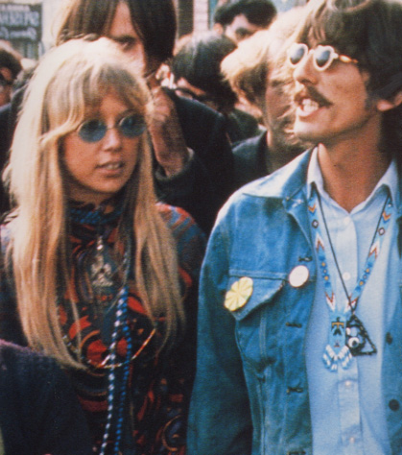
Counterculture:
A subculture where a group rejects the major values, norms, and practices of the larger society and replaces them with a new set of cultural patterns.
EX: Hippie movement in 1960s.
Others?

Slide 59
CHAPTER 2
Chapter Wrap-Up
1. List five examples of material culture and five examples of nonmaterial culture.
2. What is language, and why is it such an important part of culture?
3. How do folkways, mores, and laws differ? List three examples of each type of norm.
4. How do cultural traits, cultural complexes, and cultural patterns differ?
5. How did Margaret Mead contribute to the study of cultures?
6. What is ethnocentrism? How does it differ from cultural relativism?
7. How are subcultures and countercultures related?

