Slide 1
Psychological Disorders

Slide 2
Normal v. Abnormal
Criteria
Deviation from normality (what most people do)
Adjustment – Do no adjust physically, emotionally, or socially as others do
Psychological health
Facts
Hard to define
No clear standard

Slide 3
Classifying Mental Illness
DSM-IV
Diagnostic and Statistical Manual of Mental Disorders
Sets forth specific diagnostic criteria for disorders and helps differentiate between disorders
Labels a person – can have negative influence on person’s future
Impacts how others regard/view person

Slide 5
DSM-IV Axis
Axis I
clinical disorders and developmental and learning disorders.
Axis 2
personality disorders or mental retardation, includes autism
Axis 3
medical and/or physical conditions or disorders
Axis 4
Psychosocial & Environmental Problems
Axis 5
Overall psychological, social, and occupational functioning (scale from 1 – 100)

Slide 6
Insanity
Legal term
Many people with Psych disorders are SANE
Unaware of actions at the time of the crime
“Not guilty by reason of insanity” – studies show, held as long in mental institution as if found guilty

Slide 7
Major Disorders – Axis I – DSM-IV
DSM-IV classifies symptoms into categories
Schizophrenia
Mood Disorders
Anxiety Disorders
Somatoform Disorders
Dissociative Disorders
Eating Disorders
Sleep Disorders

Slide 8
Anxiety Disorders
Anxiety – general state of dread or uneasiness in response to imagined danger
Most common type of mental illness in US
Affects 40 million Americans annually
Generalized Anxiety Disorder – continuous or generalized anxiety
Phobic Disorder
Specific phobia – almost anything
Social phobia – speaking in public
Agoraphobia – fear of public place

Slide 9
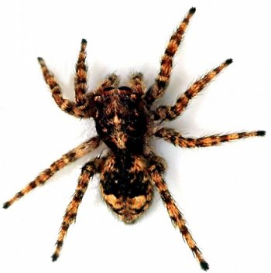
Anxiety Disorders
Phobia
Panic Disorder
OCD (As Good As it Gets, Matchstick Men)
Compulsions – repeating behaviors
Obsessions – uncontrollable thoughts
PTSD (Brothers, Reign Over Me)
Post-Traumatic Stress Disorder
Can be caused by any traumatic event (not just war)

Slide 11
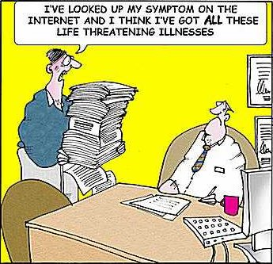
Somatoform Disorders
Physical symptoms with no physical cause apparent
Conversion disorder
Converting emotional difficulties into loss of specific physiological function
Hypochondriasis
Person in good health becomes preoccupied with imaginary ailments

Slide 12
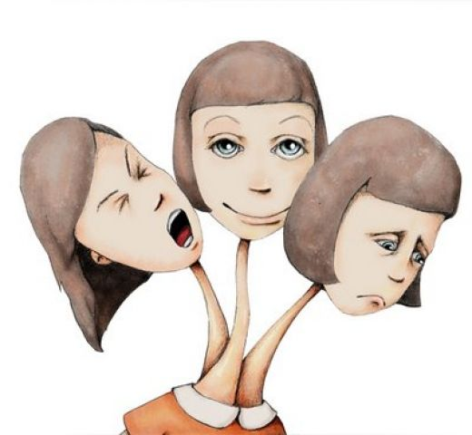
Dissociative Disorders
Alterations in memory, identity, or consciousness
Dissociative amnesia
Inability to recall personal events (rest of memory intact)
Dissociative fugue
Travels away from home or work & unable to recall past
DID – Dissociative Identity Disorder (United States of Tara)
Formerly Multiple Personality Disorder
Two or more distinct personalities
Rare and controversial

Slide 13
Dissociative Identity Disorder

Slide 14
Schizophrenia
Group of disorders
Confused and disconnected thoughts, emotions, perceptions
1% of people worldwide
Delusions (false beliefs) can occur as well as hallucinations (perceptions with no external cue)
Sped up speaking “word salad”
Types: paranoid, catatonic, disorganized
Much debate over cause
A Beautiful Mind

Slide 15
Mood Disorders
Major depressive Disorder
At least 2 weeks feeling depressed, sad, etc
Reduced ability to function with others
Bereavement does not currently count
Problems with eating, sleeping, thinking, concentrating, decision making. Lack of energy. Suicidal thoughts, feeling worthless or guilty

Slide 16
Mood Disorders
Bipolar Disorder (Cobb)
Manic phase – elation, distractibility, racing thoughts, exaggerated self-esteem
Depressive phase
Varying forms
Seasonal Affective Disorder
EX. Depression during winter

Slide 17
Suicide
More than 30,000 Americans per year
Women attempt suicide more
Men successfully complete suicide more
Most people that threaten suicide ARE serious
Upwards of 70% of people who commit suicide threatened to do so within three months preceding the suicide

Slide 18
Personality Disorders
Maladaptive or inflexible ways of dealing with others and one’s environment
Antisocial Personality Disorder (Natural Born Killers, No Country For Old Men)
Disregard for and violating rights of others without remorse
Often intelligent, entertaining, and or able to fake emotions
Borderline Personality Disorder (Girl, Interrupted)
Unstable emotions, fear of abandonment, inappropriate anger, feelings of worthlessness, impulsive, self-injury

Slide 19
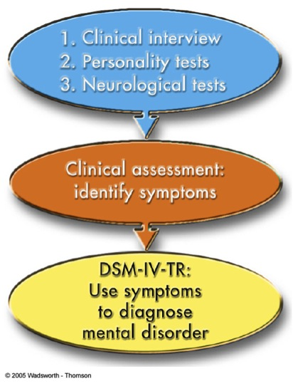
Psychotherapy
Treatment used by therapists to help trouble people overcome their problems
Verbal interaction between therapist and client
Development of a supportive and trusting relationship
Analysis by the therapist of the client’s problems
Help people understand and take ownership in solving problems
Can take on many forms

Slide 20
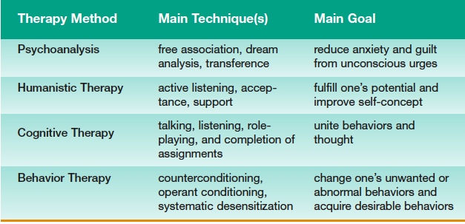

Slide 21
Group Therapy
Patients work together with the aid of a leader
Helps patients see how other people are struggling with similar problems
One therapist can help a large number at a reduced cost
Cognitive-Behavioral Therapy
Substituting healthy thoughts for negative ones
Changing disruptive behaviors for healthy ones

