Slide 1
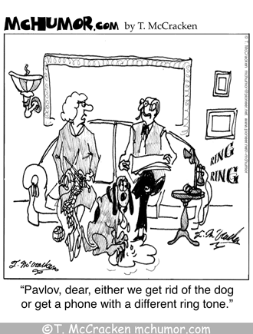
PSYCHOLOGY:
LEARNING
Learning can be defined as the process leading to relatively permanent behavioral change or potential behavioral change.

Slide 2
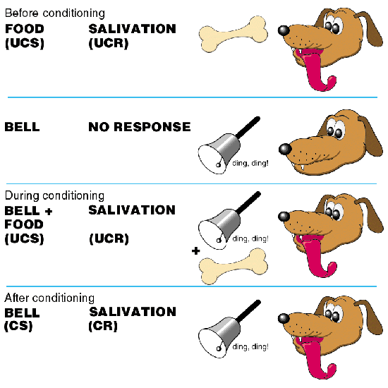
Classical Conditioning
Ivan Pavlov’s method of conditioning in which associations are made between a natural stimulus and a learned, neutral stimulus.

Slide 3
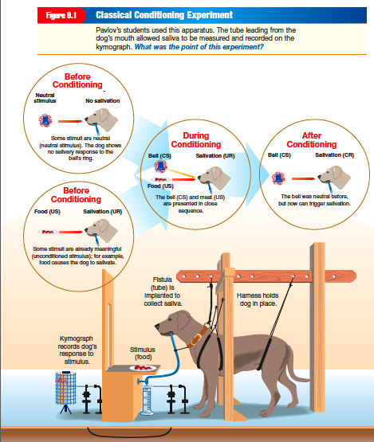

Slide 5
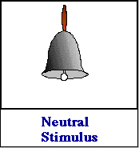
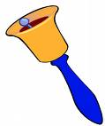
Stimulus generalization occurs when a response spreads from one specific stimulus to other stimuli that resemble the original (responding to any bell sound, no matter what pitch)
Notes:
If stimulus generalization had occurred with someone who had learned to be afraid of the ocean, what other things could cause a fear response in that person? (a lake, river, bathtub, pool)

Slide 6
Discrimination is the ability to respond differently to distinct stimuli. (only responding to one type of bell)

Slide 7
Extinction the gradual loss of an association over time. The conditioned response (CR) will gradually die out

Slide 8
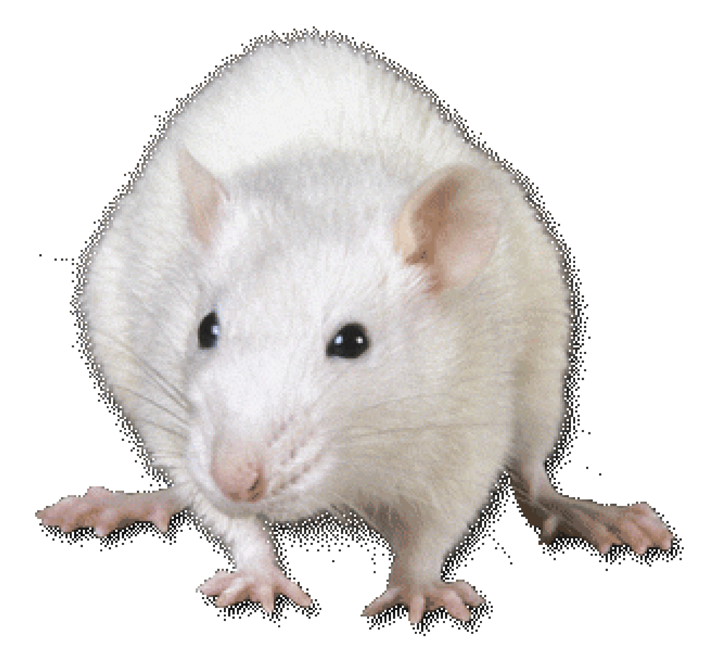
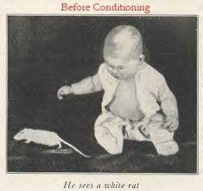
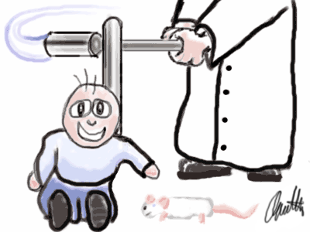
Little Albert experiment conducted by John Watson proved that conditioning of emotions to neutral objects is possible
Notes:
Watson showed that fear can be learned through classical conditioning (ex. Sound of a gun shot can cause fear in war vets)
Albert was shown a white rat and several other animals. At first Albert was not afraid. Then, the experimenter began making a loud noise behind Albert every time he saw the white rat. Eventually Albert feared the rat without the loud noise. Soon Albert feared all the animals = stimulus generalization.

Slide 9
CLASSICAL CONDITIONING AND ADVERTISING
Ways in which classical conditioning helps sell…
Pairing popular music together with products in ads to generate positive feelings
Consistently advertising a product on an exciting game show may result in the product itself generating excitement
Christmas music played in a story may trigger happy memories in a consumer’s mind persuading them to enter the store.
Before we have heard of a product, it is Neutral. If we associate the product (N) with pleasant images (UCS), which produce pleasant feelings (UCR), the product (CS) will later create pleasant feelings (CR).

Slide 10
Let’s say you have a beverage commercial that includes barely clothed models drinking the product. Conditioning is taking place.
Neutral: beverage product
UCS: barely clothed models
UCR: pleasant feelings
CS: the product
CR: pleasant feelings
Notes:
Generate a list of 5 – 10 things that they have learned through classical conditioning in their lives. Pick one and try to identify the UCS, UCR, CS, CR.

Slide 11
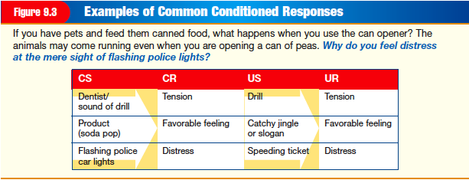
Food and Classical Conditioning
Taste-aversion - associating a (smell, taste, sound, or sight) with getting sick and thereafter avoiding that particular (smell, taste, sound, or sight) in the future.
Helps rats learn not to eat poison.

Slide 12
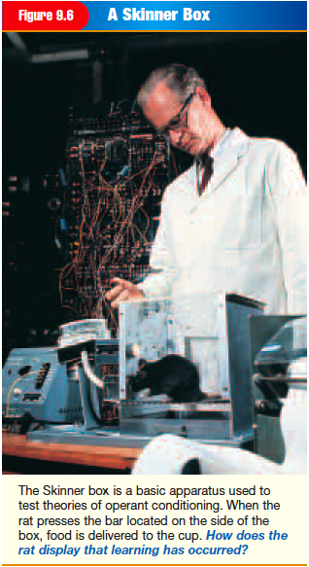
OPERANT CONDITIONING
Learning in which a certain action is reinforced or punished, resulting in behavioral change
Notes:
Imagine the last time you made a mistake; you most likely remember that mistake and do things differently when the situation comes up again. In that sense, you’ve learned to act differently based on the natural consequences of your previous actions
Operant Conditioning involves learned voluntary responses (ones we control)

Slide 13
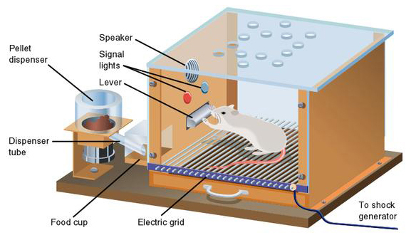
B.F. Skinner is best known for his work with the operant conditioning theory.
Believed that how we turn out is a direct result of what we learn from all of the operations (operant) that we make over the years
Skinner
Box

Slide 14
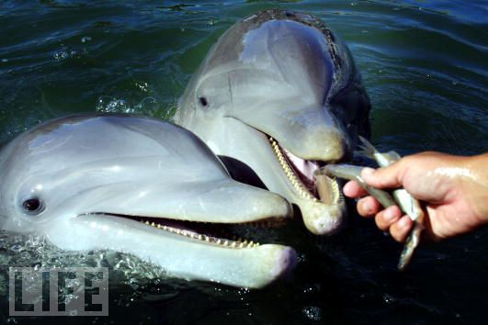
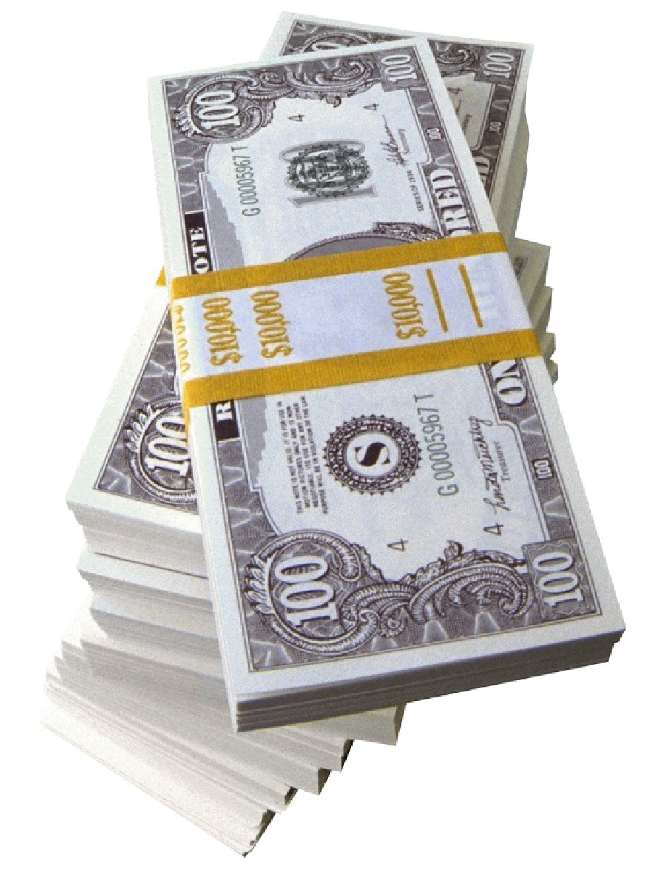
Reinforcement is something that follows a response and strengthens the tendency to repeat that response
PRIMARY & SECONDARY REINFORCERS
Primary reinforcement is something that is necessary for survival. Ex: food or water
Secondary reinforcement is a stimulus that we have learned to value (linked to a primary reinforcer)
Notes:
When a contractor reinforces something, he is strengthening it.
Primary Reinforcement Examples:
Dessert as a reward for eating vegetables
Dolphin gets a fish for performing trick

Slide 15
Schedules of Reinforcement
Reinforcement is more successful when it DOES NOT follow every desired behavior
INTERVAL SCHEDULES deal with the amount of TIME that elapses
RATIO SCHEDULES deal with BEHAVIORS or a certain # OF CORRECT RESPONSES

Slide 16
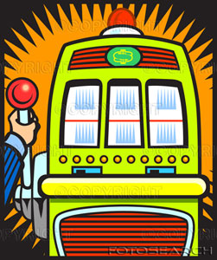
Variable ratios schedule is when an unpredictable number of responses are required before reinforcement can be obtained. Ex. slot machines.

Slide 17
Fixed ratio schedule a specific number of correct responses is required before reinforcement can be obtained. Ex. Buy 10 haircuts get 1 free.

Slide 18
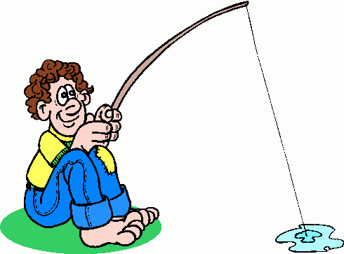
Variable interval schedule is when the reinforcement occurs after varying amounts of time. Ex. Fishing and catching a fish after varying amounts of time

Slide 19
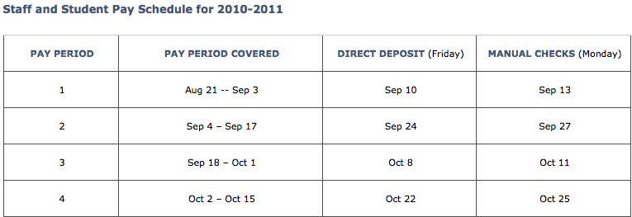
Fixed interval schedule is when the reinforcement is received after a fixed amount of time has passed. Ex. You get allowance every other Friday.
Notes:
Intervals are dealing with time.

Slide 20
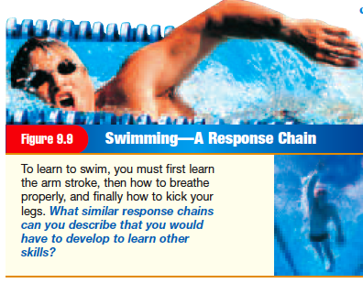
Shaping is the process of gradually refining a response by successively reinforcing closer versions of it. (teach animals tricks)(learn a new skill)

Slide 21
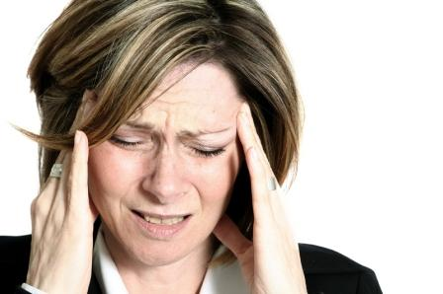
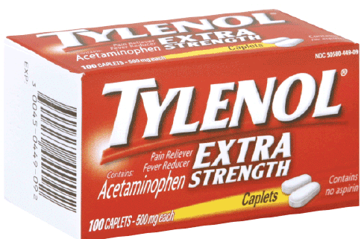
Negative reinforcement is when something that is unpleasant is stopped or taken away when something is done
Headache stops when you take Tylenol so you strengthened the behavior of taking Tylenol
Reinforcement always strengthens a response, rather than weakening it.

Slide 22
Punishment involves decreasing the frequency of a behavior.
Punishment always weakens a response, rather than strengthening it.

Slide 23
 | POSITIVE (ADDED) | NEGATIVE (SUBTRACTED)
REINFORCEMENT (STRENGTHENS) | Clean the house and earn $5 a coach pats you on the back after a good play a paycheck for working $10 for getting an “A” on your report card Senior privilege for maintaining good grades | You buy your child ice cream so they stop nagging You leave early for school to avoid traffic You take Tylenol to remove back pain
PUNISHMENT (WEAKENS) | You get your mouth washed out with soap when you curse Touch and hot stove and get burned Getting a ticket for speeding | You lose your driving privileges for breaking curfew Time out, or the loss of freedom to combat bad behavior You pay money for a speeding ticket

Slide 24
Social Learning
The process of altering behavior by observing and imitating others. Includes cognitive learning & Modeling
Cognitive Learning – involves mental process and may involve observation and imitation
Cognitive Map – mental picture of a place

Slide 25
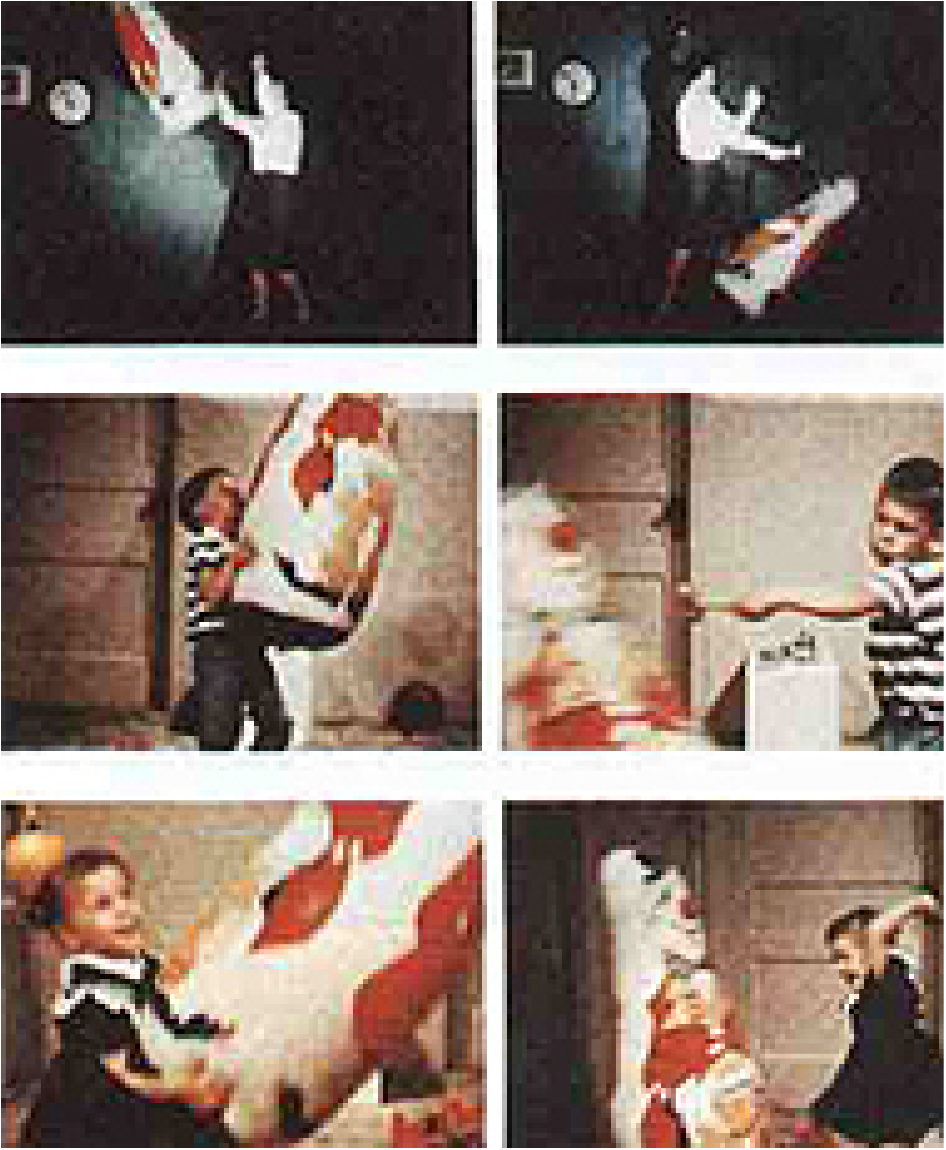
Modeling – learning by imitating/copying
Bobo-Doll Experiment
Bandura demonstrated that children learn aggressive behaviors by watching an adult’s aggressive behaviors.

Slide 26
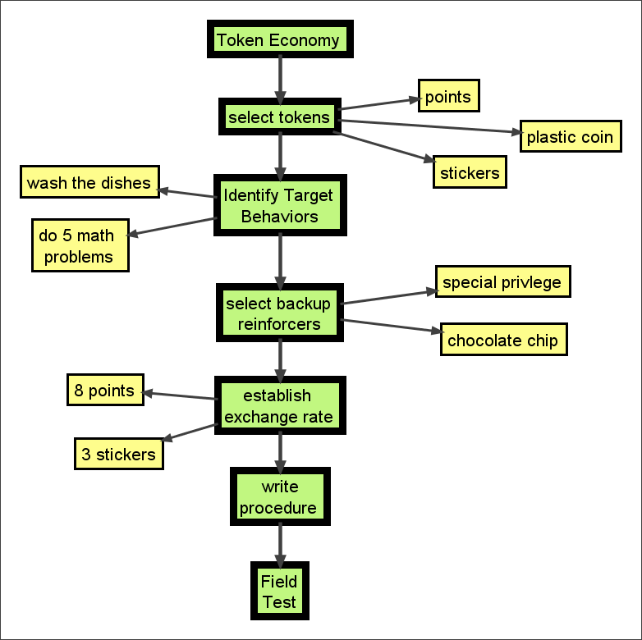
TOKEN ECONOMY
Desirable behavior is reinforced with valueless objects, which can be accumulated and exchanged for valued rewards

